Slide 1

Python DS&A
DS & A
[Team project]
— Python DS&A 프로젝트 설계 제안 —

Slide 2
Python DS&A
🎮 Python DS&A project — DS&A 7 with algorithm
📡
📚
🎯
Dungeon Map
Undo System
Turn Management
🌳
🔺
📊
Item inventories
Enemy AI
Leaderboard

Slide 3
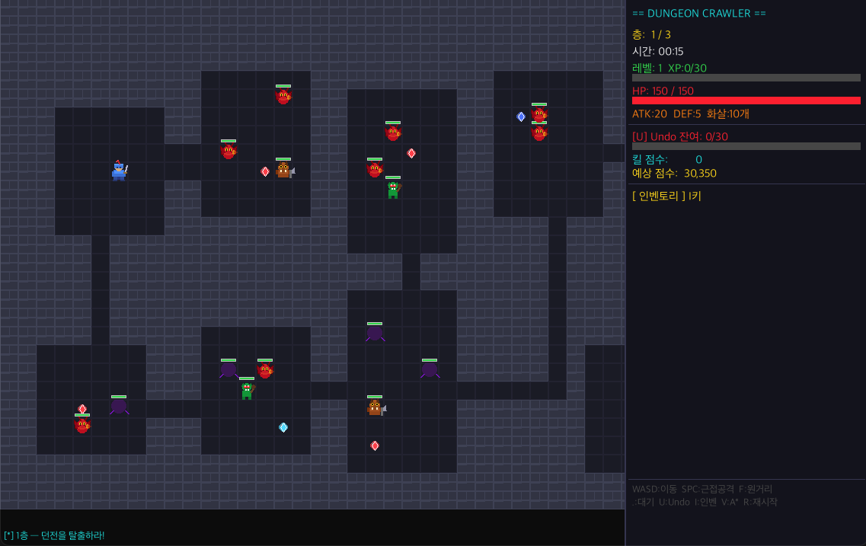
Python DS&A
1. Dungeon Map

Slide 4
Python DS&A
2. Undo System

Slide 5
Python DS&A
3. Turn Management

Slide 6
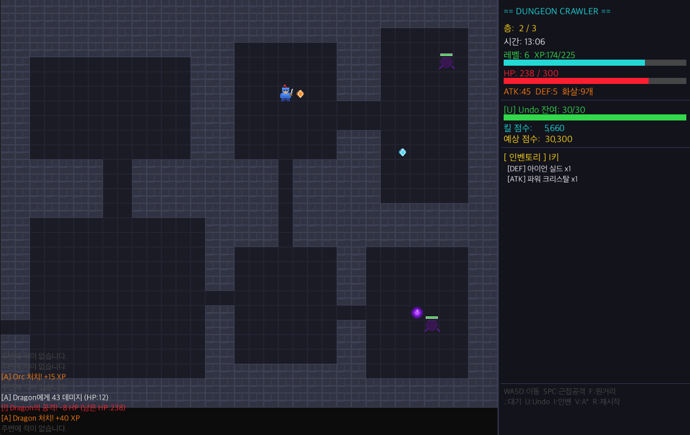
Python DS&A
4. Item Inventories

Slide 7
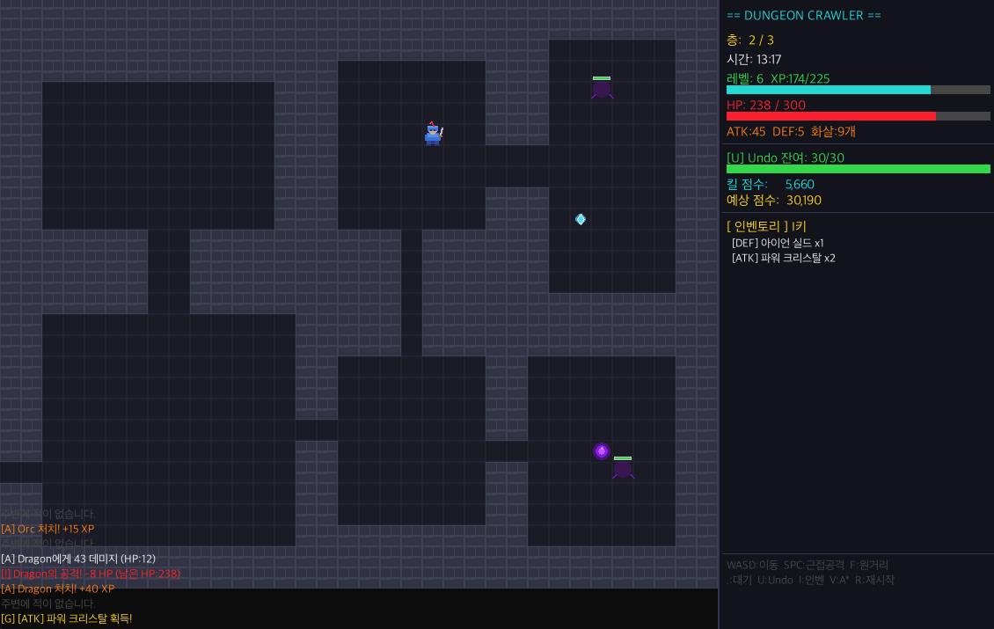
Python DS&A
4. Item Inventories

Slide 8
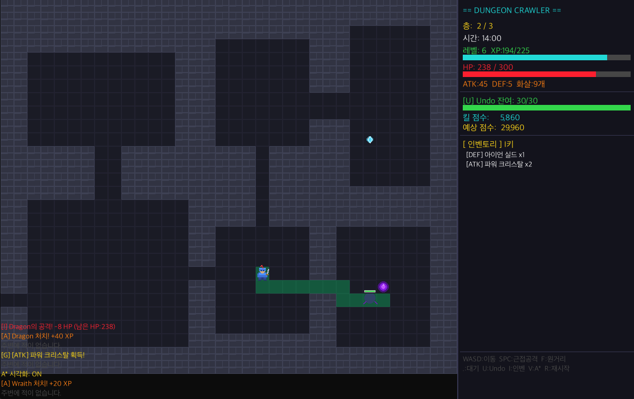
Python DS&A
5. Enemy AI

Slide 9
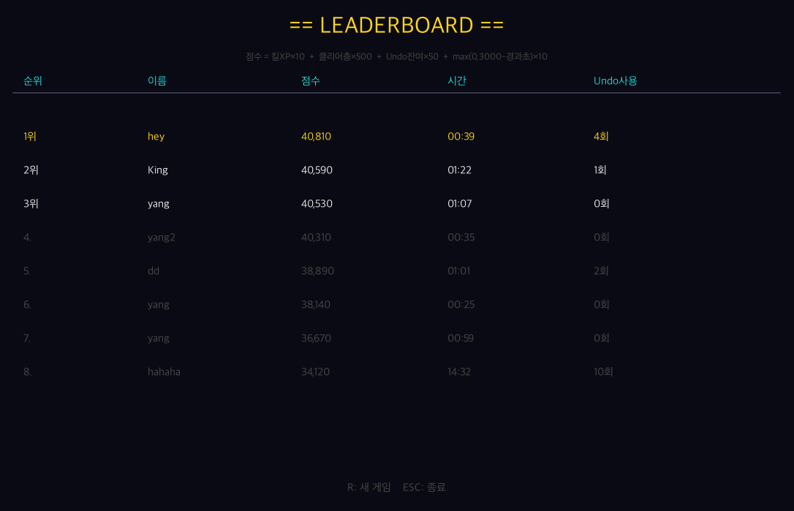
Python DS&A
6. Leaderboard

Slide 10
Python DS&A
Q&A

